Slide 1
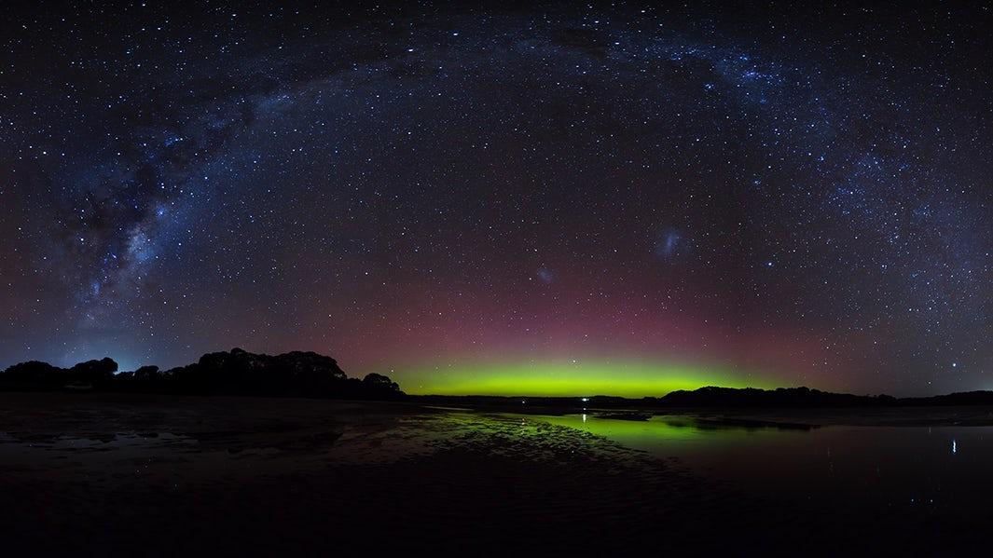
Surveying the Agents of Galaxy Evolution Early Release Science

Slide 2


Slide 3
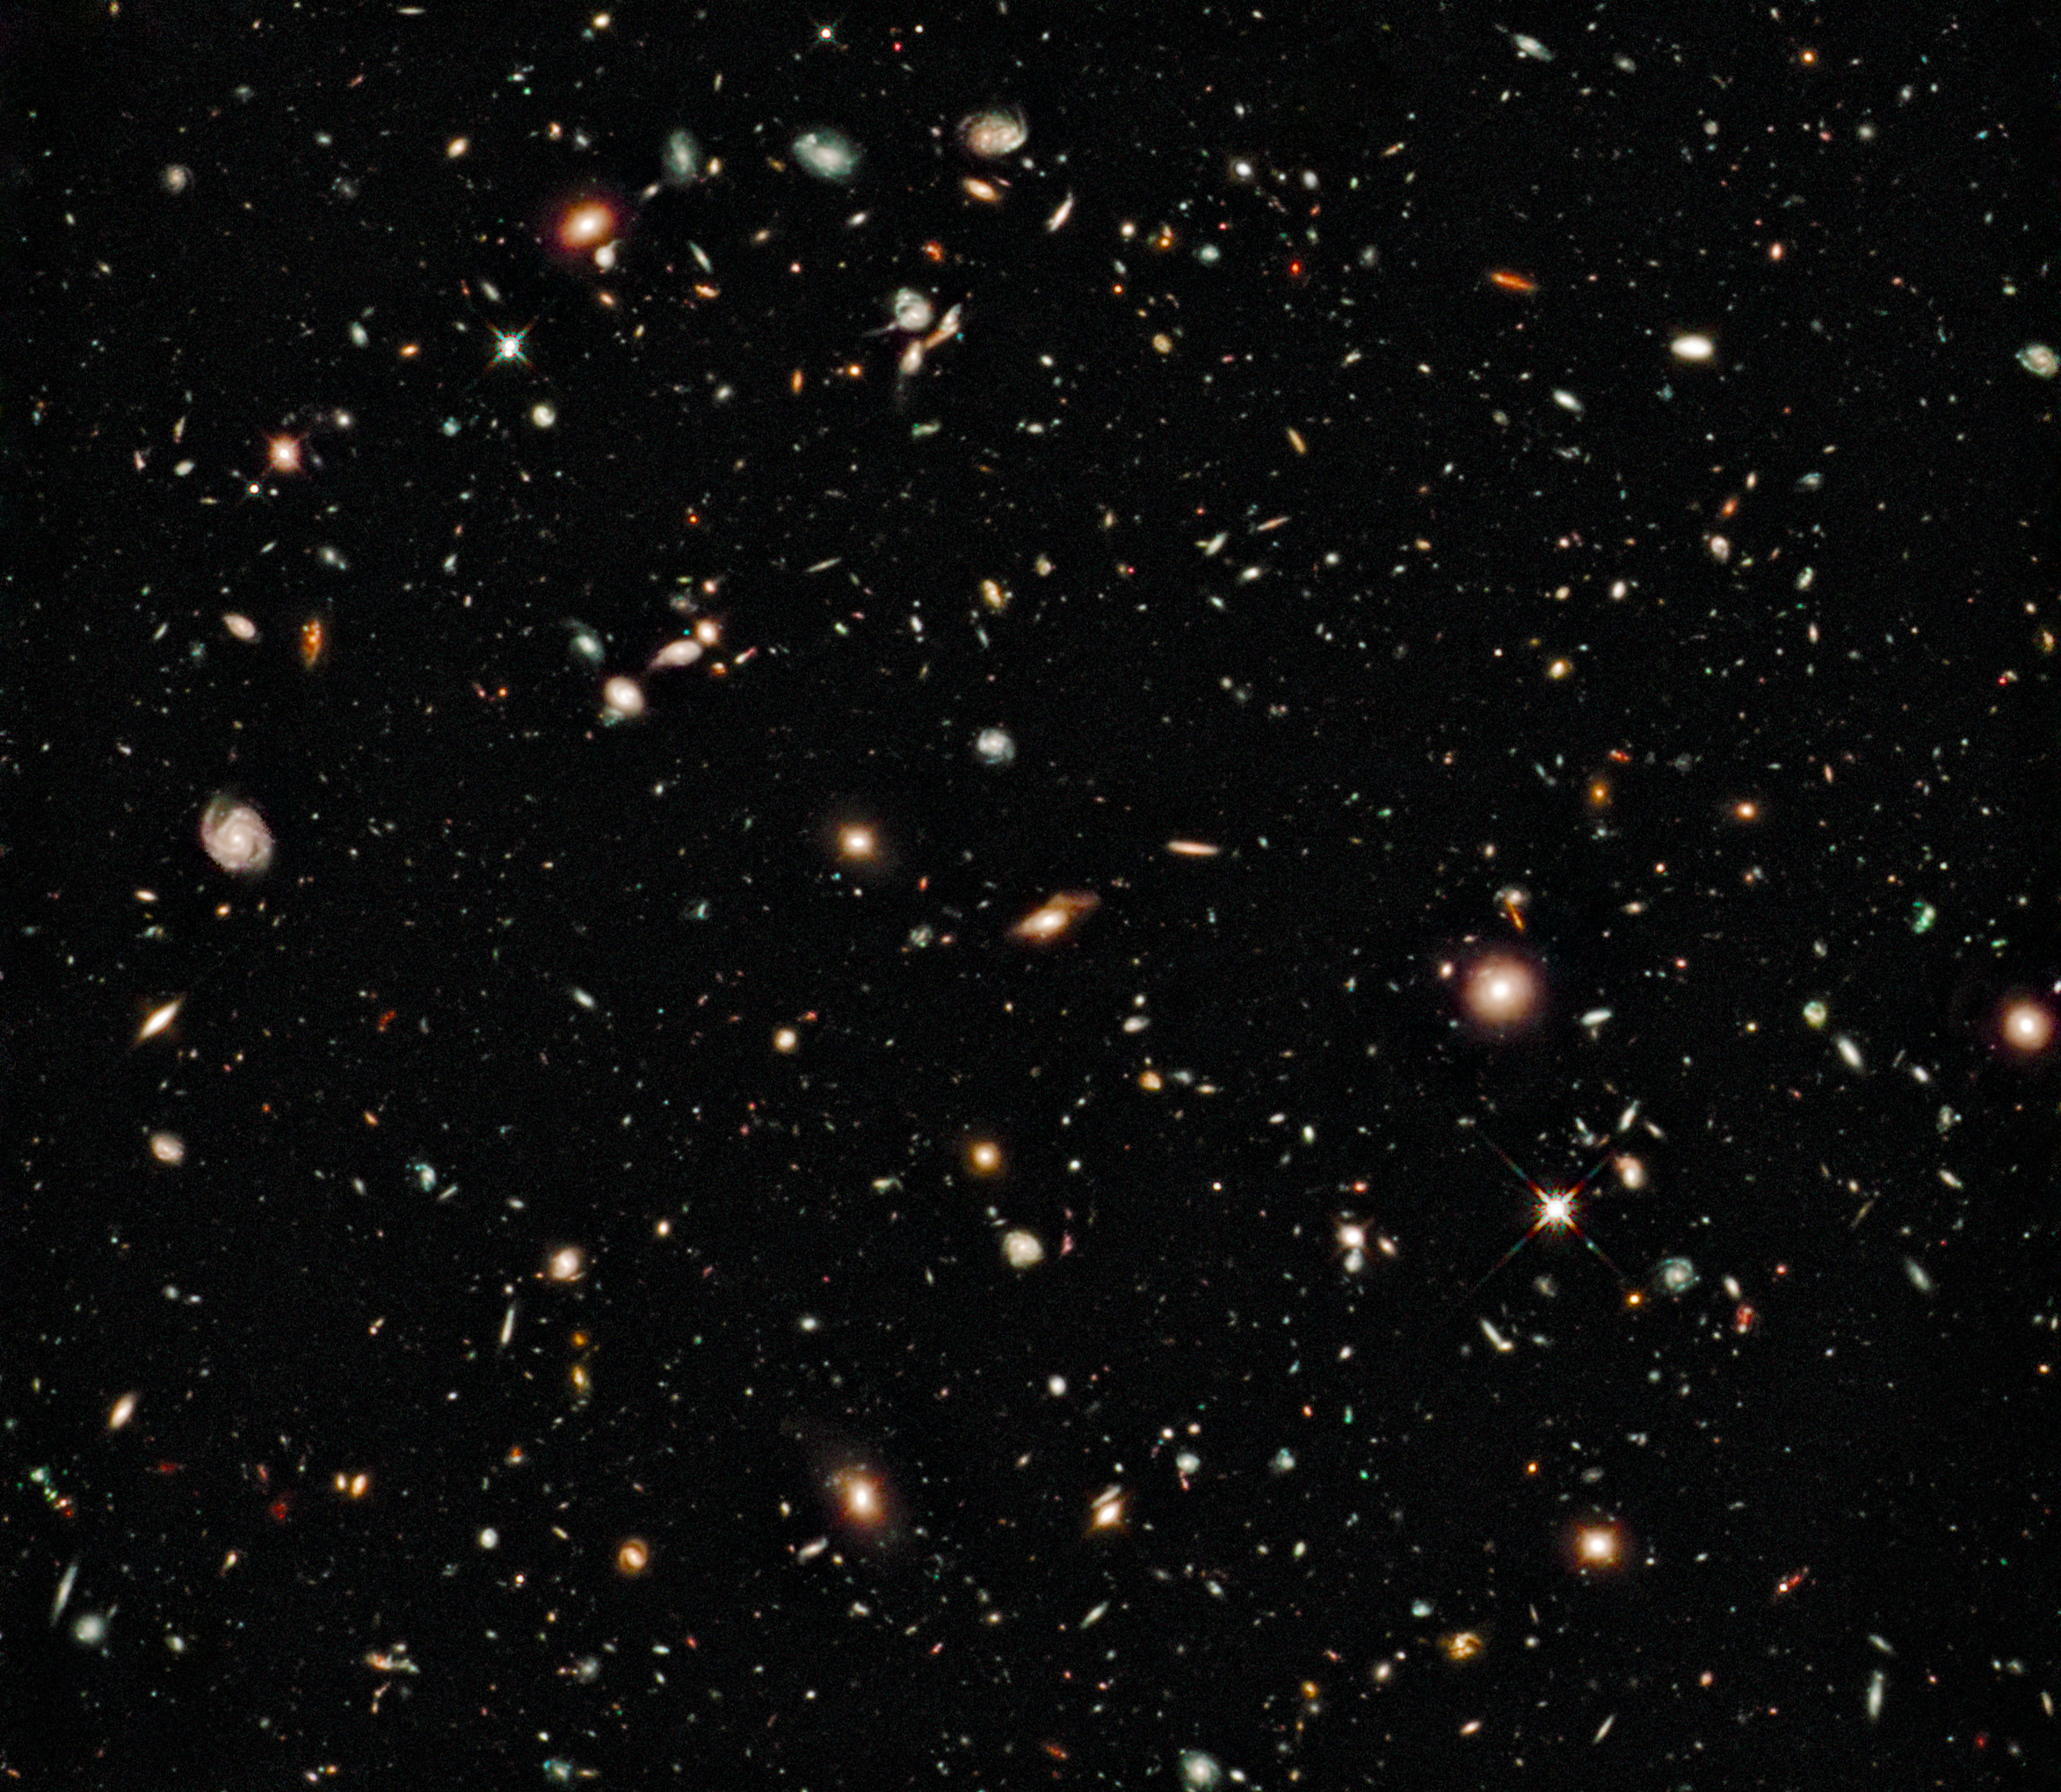

Slide 4
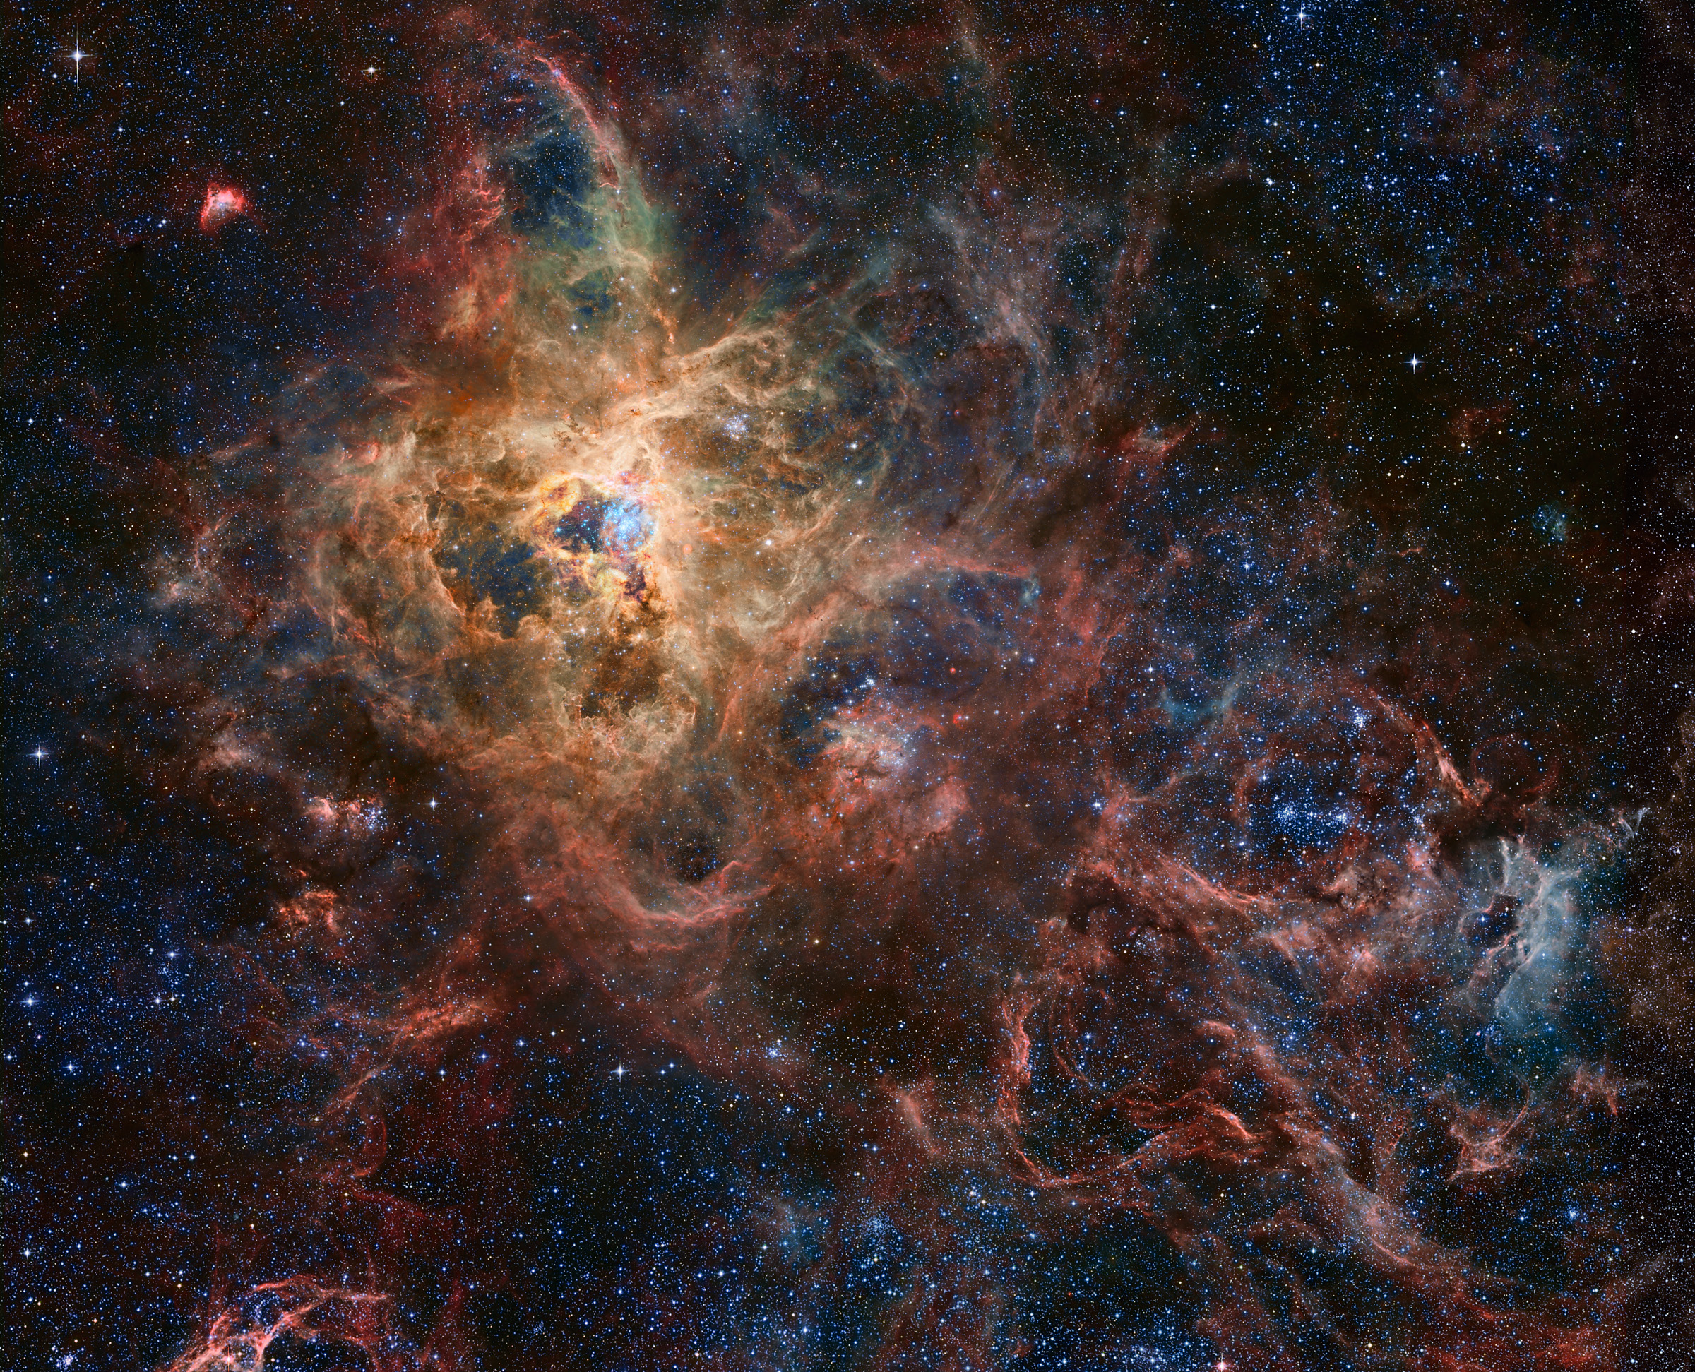

Slide 5
Surveying the Agents of Galaxy Evolution
Margaret Meixner, Ciska Kemper, Alberto Bolatto, Karl Gordon + many others
Large Magellanic Cloud (~0.5 Z @ 50 kpc)
Small Magellanic Cloud (~0.2 Z @ 60 kpc)
Spitzer IRAC/MIPS imaging of the entire galaxies
Spitzer IRS/MIPSED spectroscopy of >1000 point sources + maps
benefitting from a host of multi-wavelength ancillary surveys

Slide 6
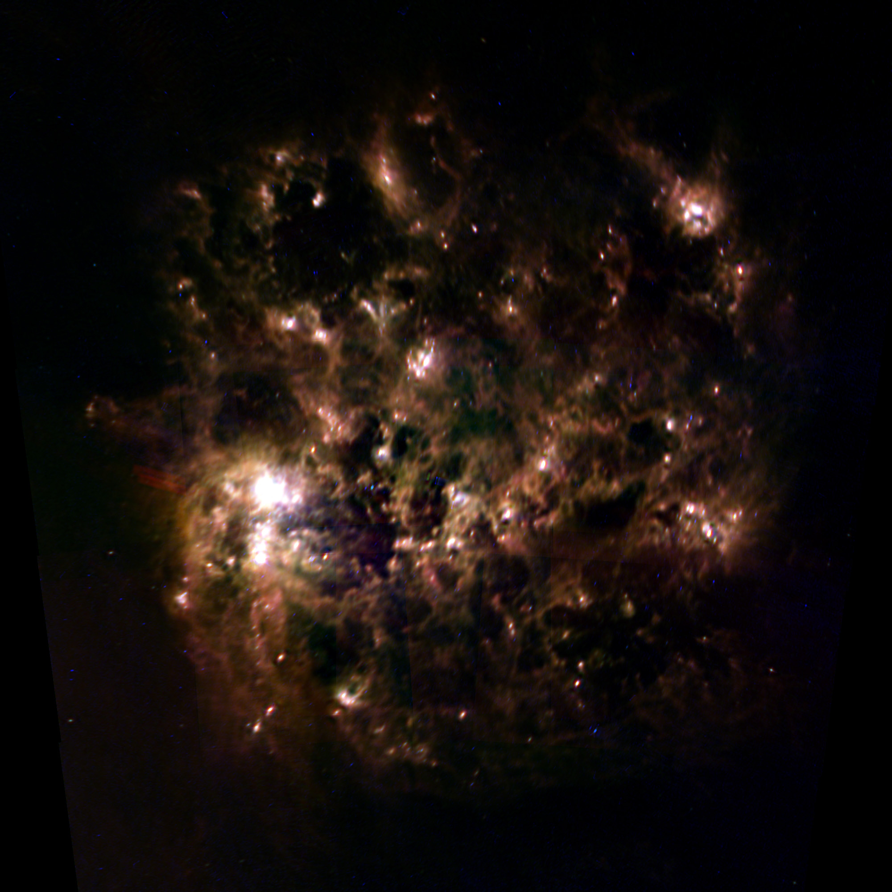
IRAS

Slide 7
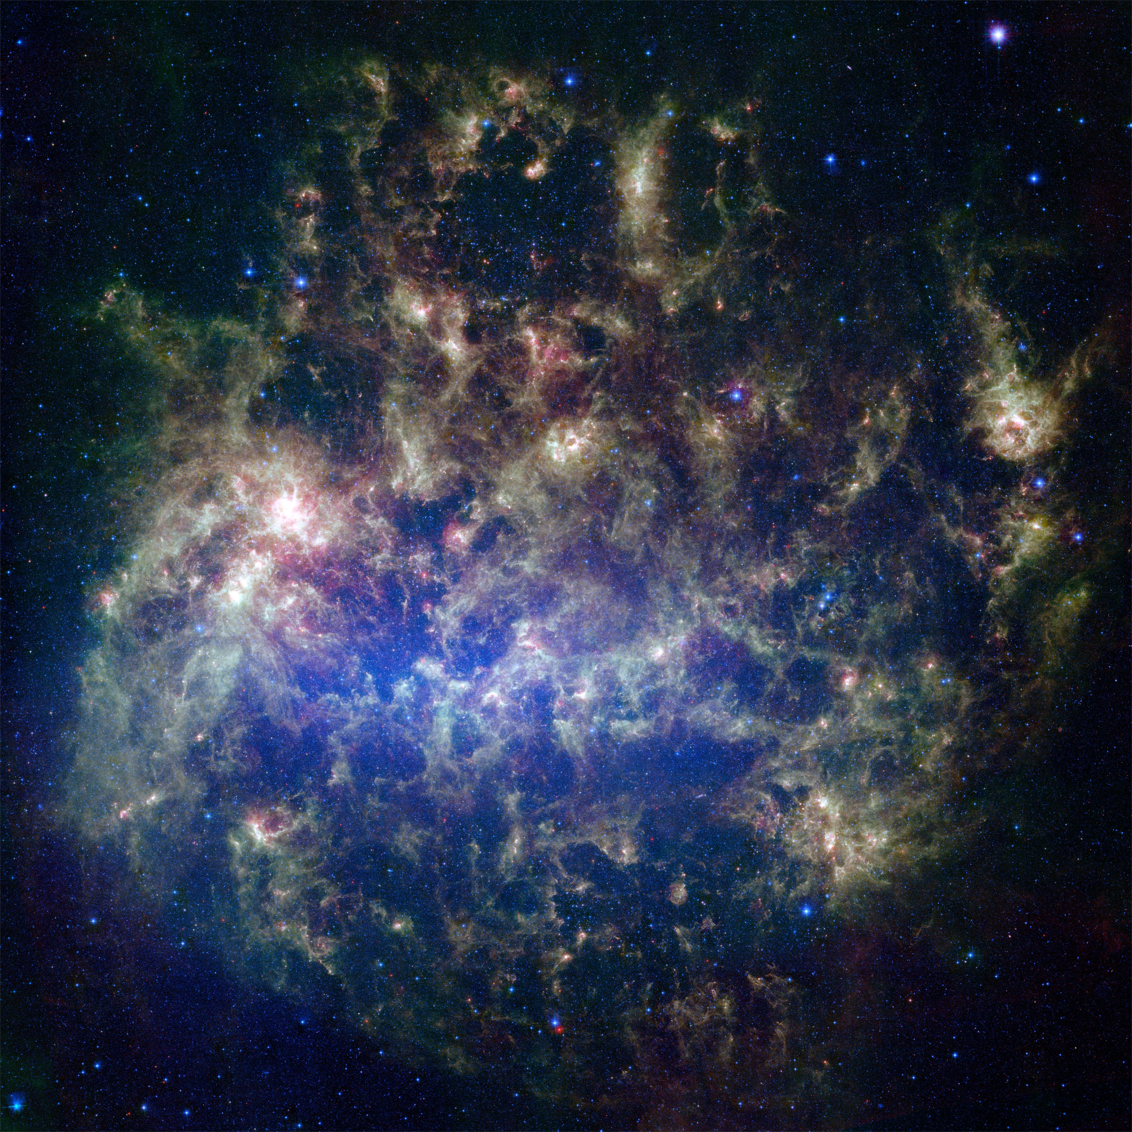
Spitzer

Slide 8
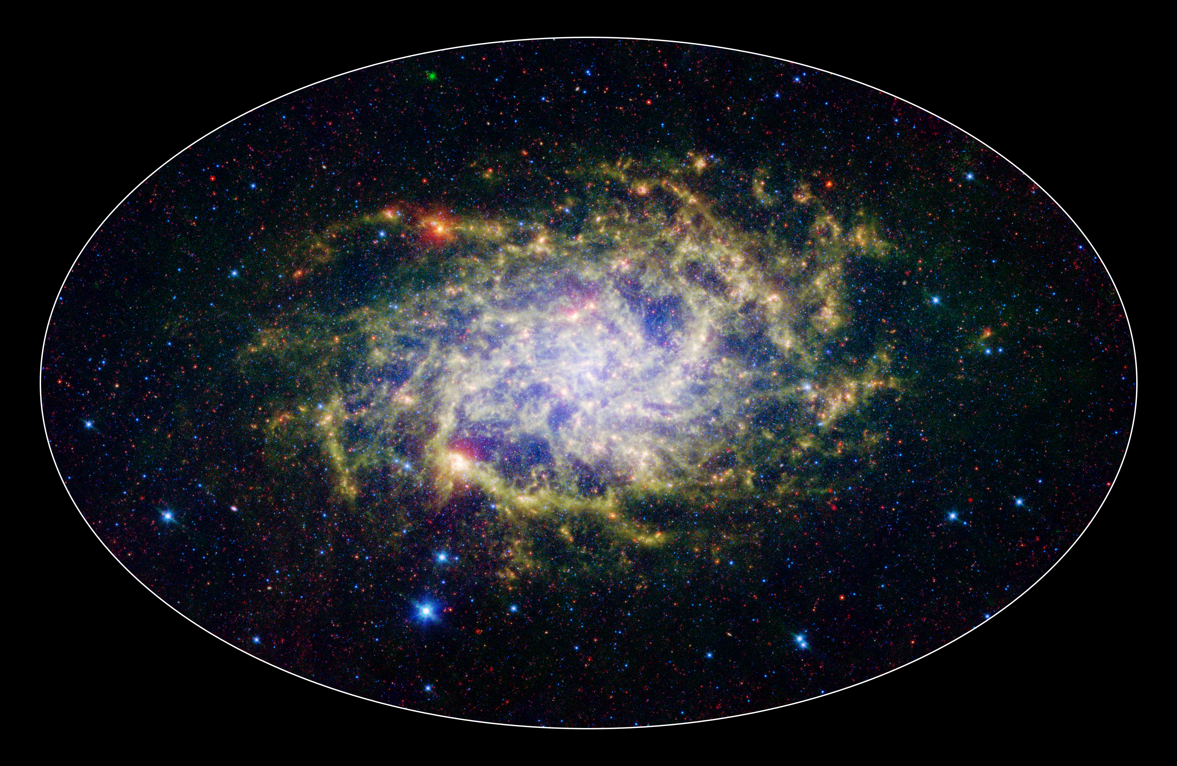
Spitzer

Slide 9
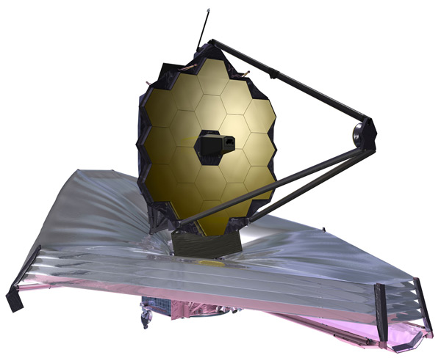
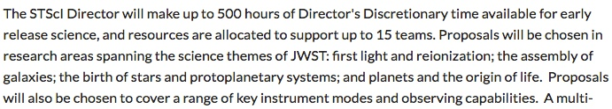
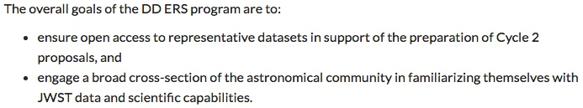
Early Release Science
200 notices of intent were submitted

Slide 10
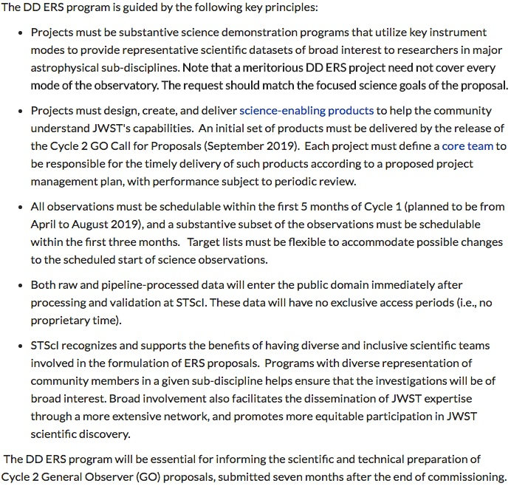

Slide 11
SAGE-ERS
Jacco van Loon, Joana Oliveira, Ciska Kemper + many others (~100)
M 31
NGC 300
Sextans A
( ~1-2 Z
(~0.5-1 Z
( <0.1 Z
@ 0.8 Mpc)
@ 1.9 Mpc)
@ 1.4 Mpc)
MIRI/NIRCam broad- & narrow-band imaging (dust, PAH, H₂, ice…)
multi-object & slitless spectroscopy ( + molecules, atomic lines)
example single-slit spectra & IFU spectral maps
evolved stars, protostars, PDRs
tip of main sequence star formation history
benefitting from a host of multi-wavelength ancillary surveys

Slide 12
M 31
1
NGC 300
LMC
METALLICITY (solar)
SMC
0.1
Sextans A
10⁸
MASS (solar)
10¹¹

Slide 13
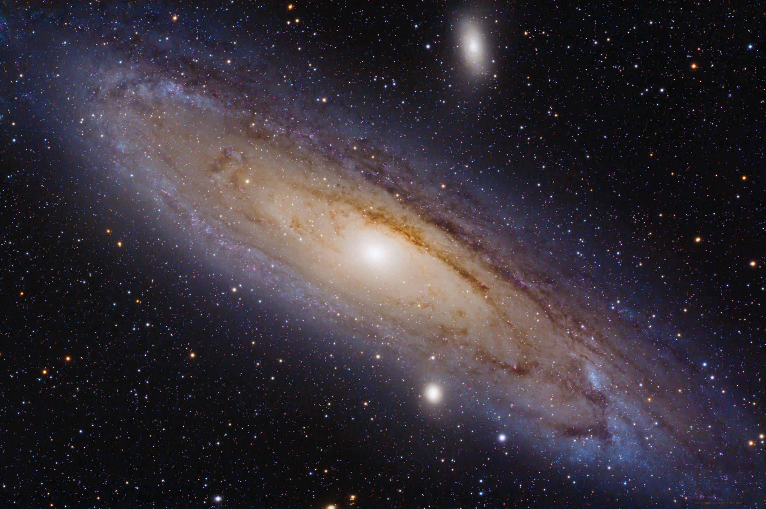
M 31

Slide 14
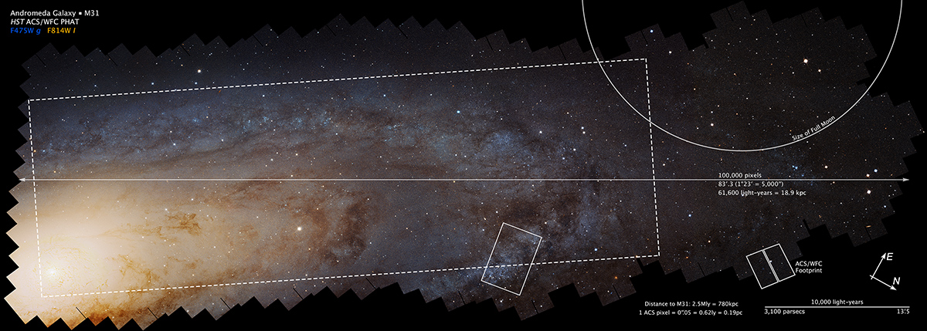
Panchromatic Hubble Andromeda Treasury

Slide 15
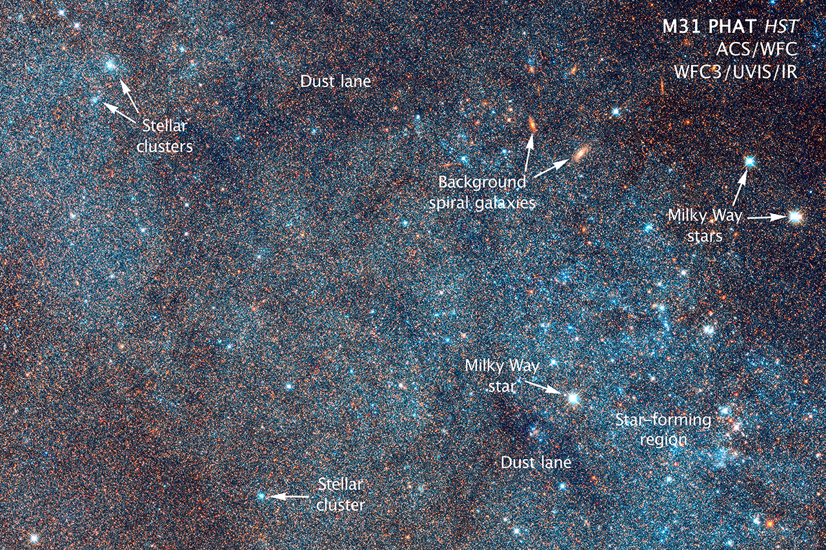
Panchromatic Hubble Andromeda Treasury

Slide 16
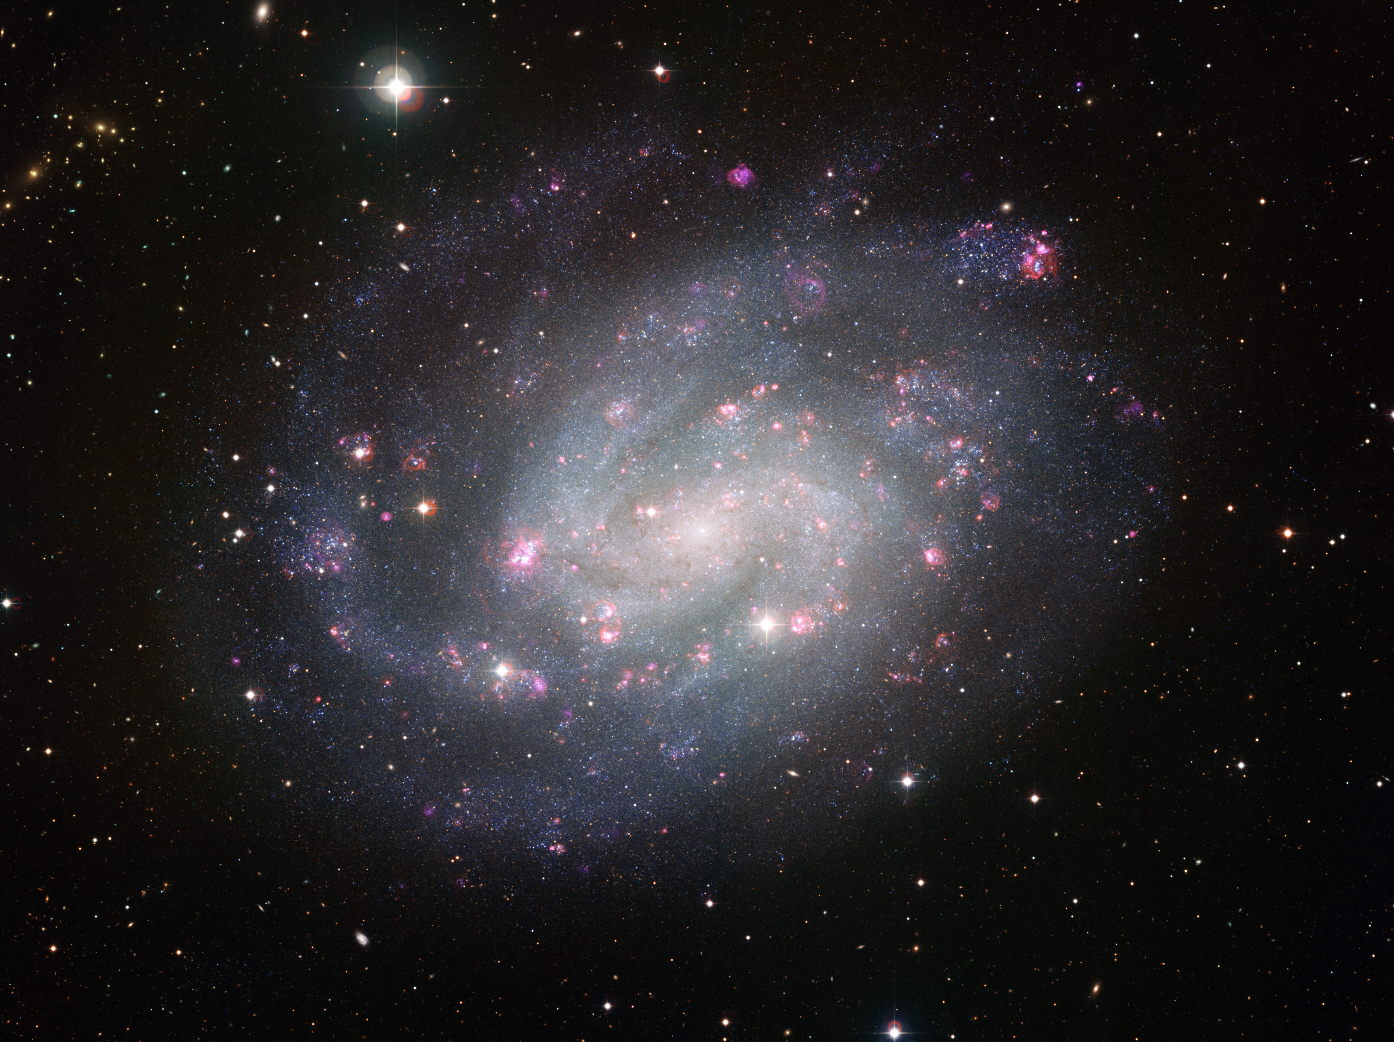
NGC 300

Slide 17
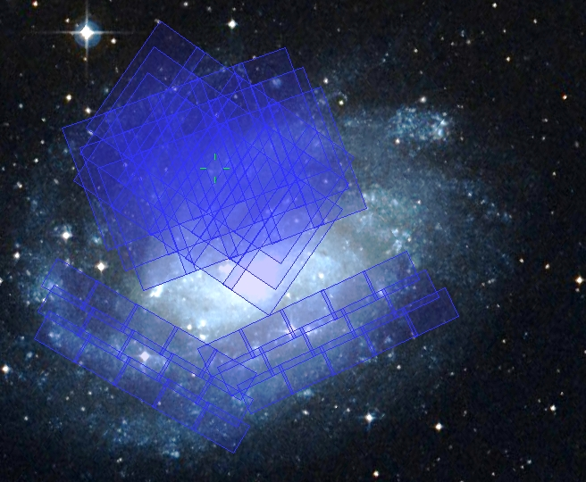

Slide 18
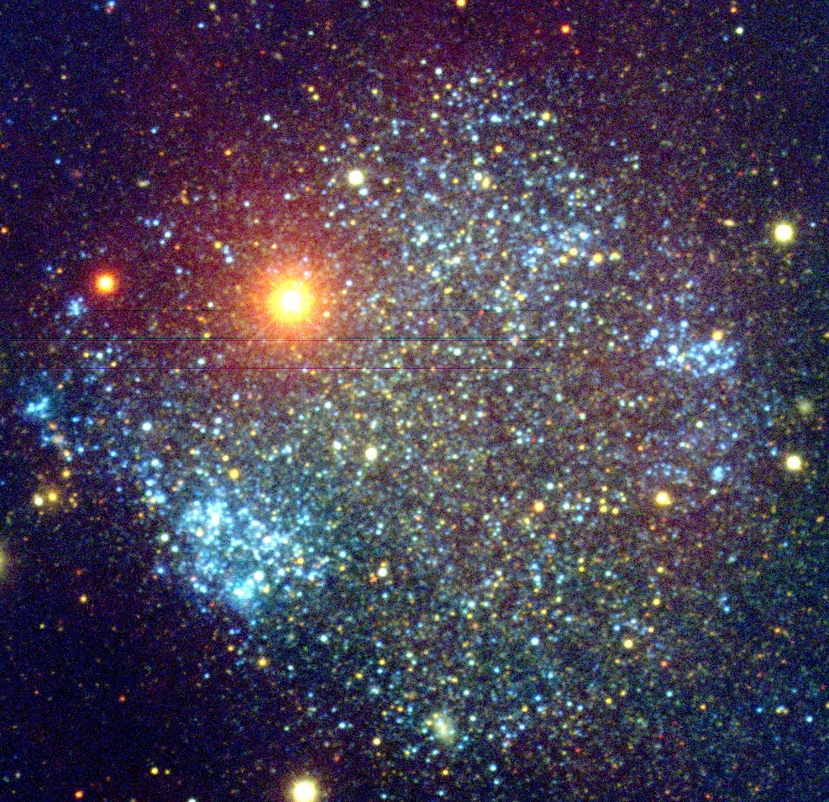
Sextans A

Slide 19
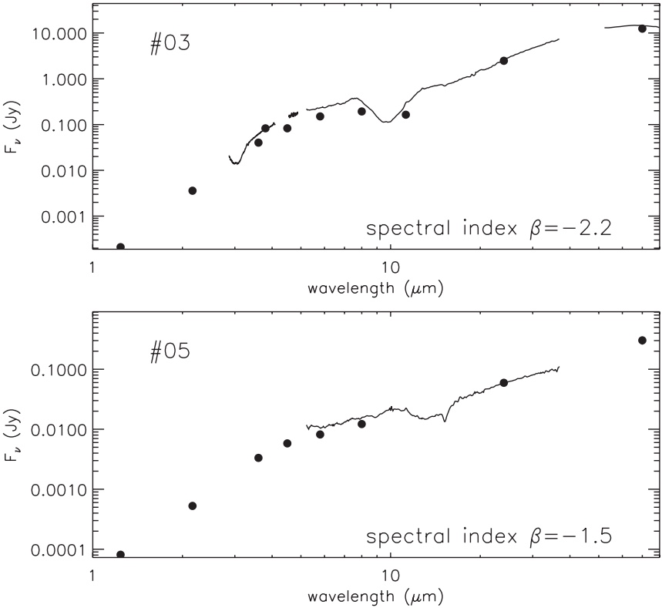
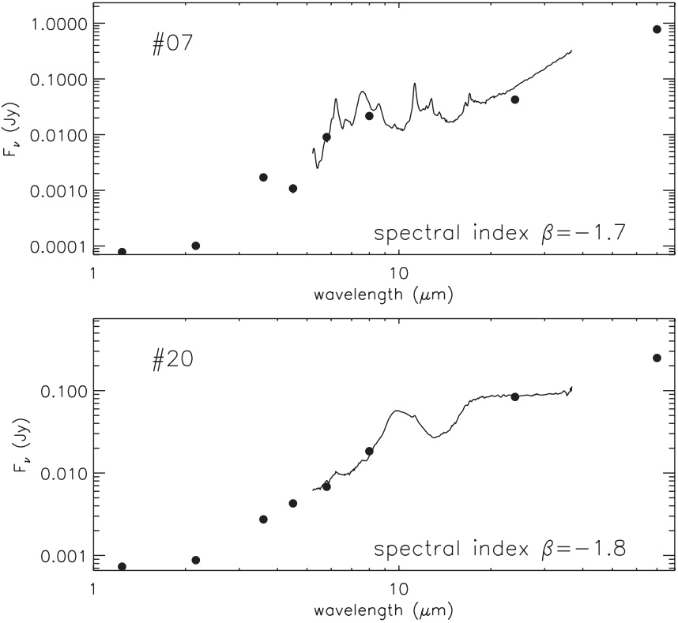
Example: IR spectra of young stellar objects in the SMC
PAHs
water ice
silicate absorption
water ice
CO₂ ice
silicate emission
Oliveira et al. (2013)

Slide 20
interested but not yet a member?
contact Joana Oliveira
j.oliveira@keele.ac.uk

